Slide 1
Dialogue Systems
USC CSCI 544: Applied Natural Language Processing
Jonathan May -- 梅約納
Nanyun (Violet) Peng – 彭楠赟
November 14, 2018
Slides from Jurafsky, Mrkšić

Slide 2
Conversation Is Special
It's the prime way we use language
It's the oldest way we use language
It's the prime way we learn language
Being able to have a conversation is in a sense what makes us human

Slide 3
Every Use of Language Technology is a Threat to Conversation
"Social media is alienating and robs us of our humanity. What about real friends?"
"Don't email your mother, call her"
"No playing video games/watching television/listening to the radio/reading books at the dinner table. Tell me about your day"
"[Writing] will create forgetfulness in the learners’ souls, because they will not use their memories; they will trust to the external written characters and not remember of themselves. " – The Phaedrus (Plato, discussing Socrates), 895 AD

Slide 4


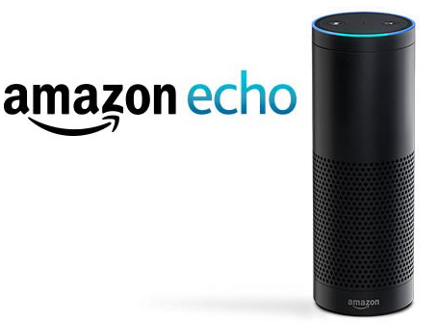

Conversational Agents AKA Dialog Agents
Phone-based Personal Assistants
SIRI, Alexa, Cortana, Google Assistant
Talking to your car
Communicating with robots
Clinical uses for mental health
Chatting for fun

Slide 5
SIRI around 2014

Slide 6
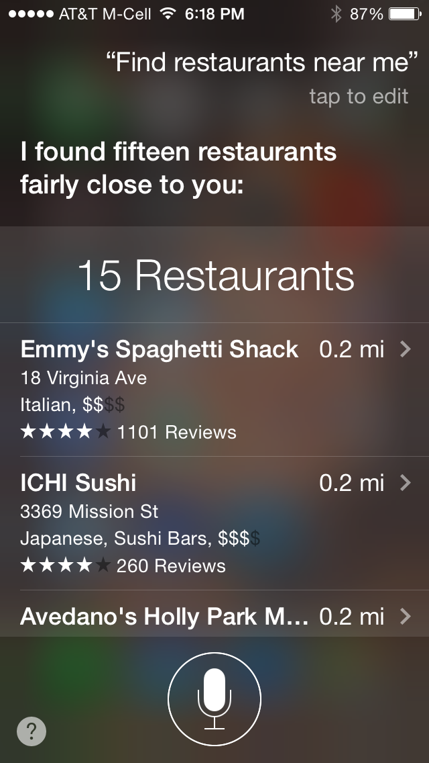
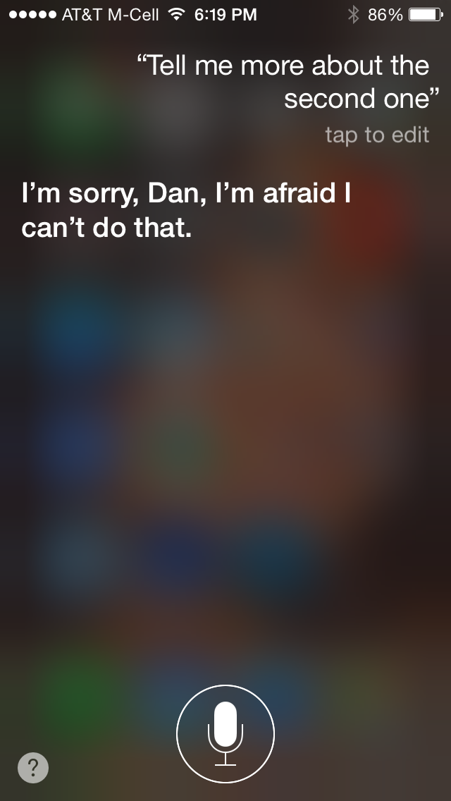

Slide 7
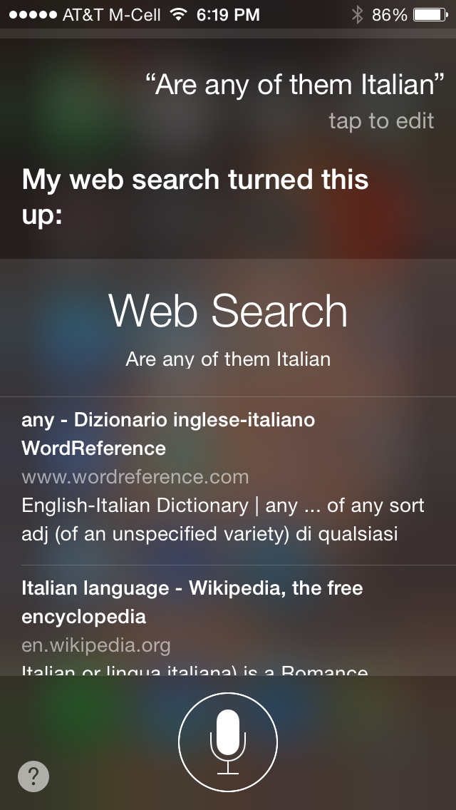

Slide 8
SIRI in February 2017

Slide 9
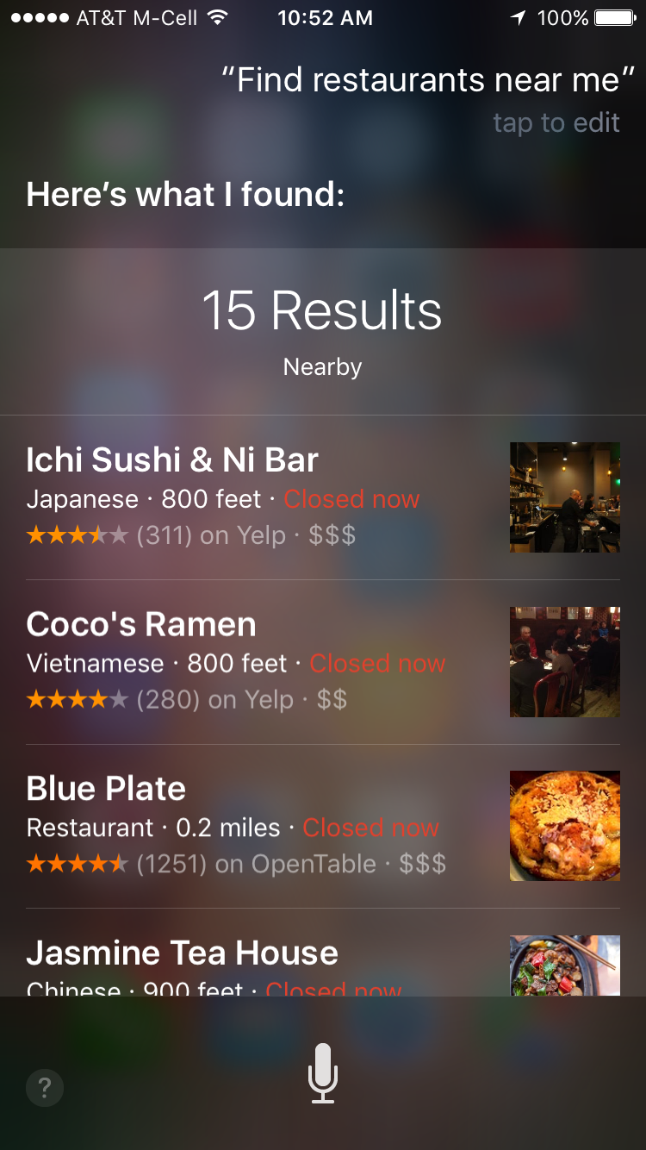
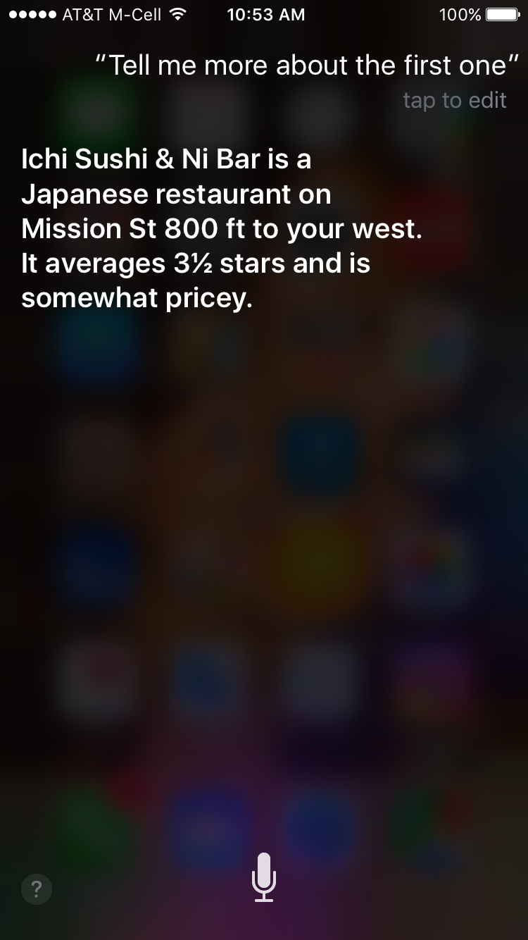

Slide 10
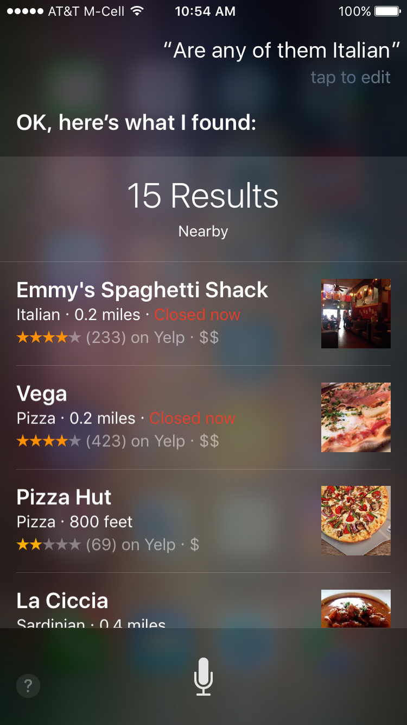

Slide 11
Key Difference
Number of turns
2014: basically 1
2017: 2, or maybe more...

Slide 12
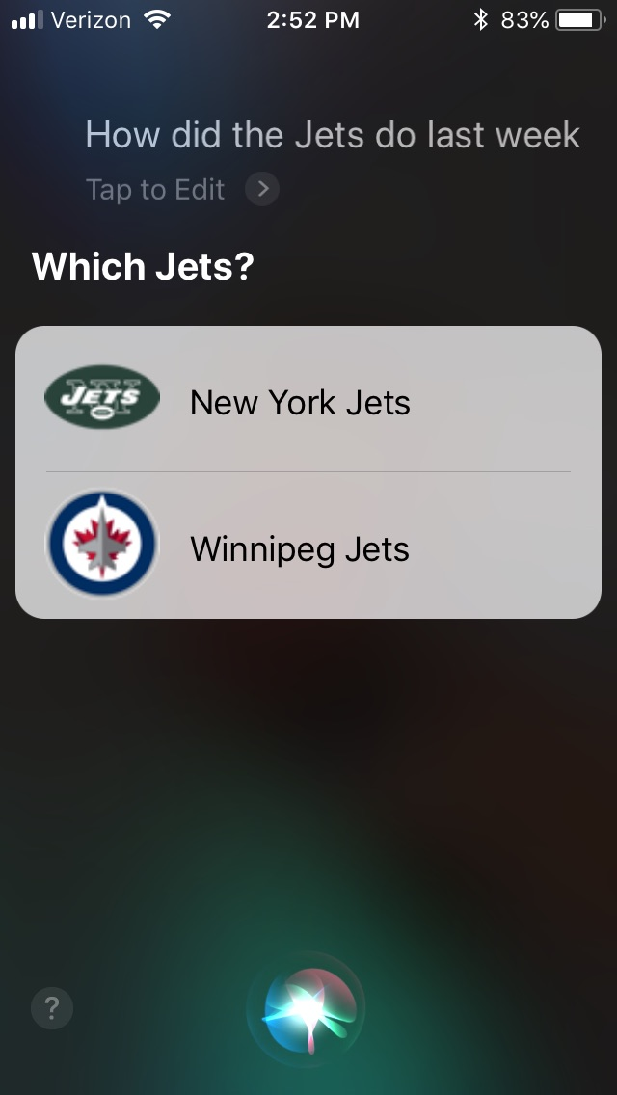
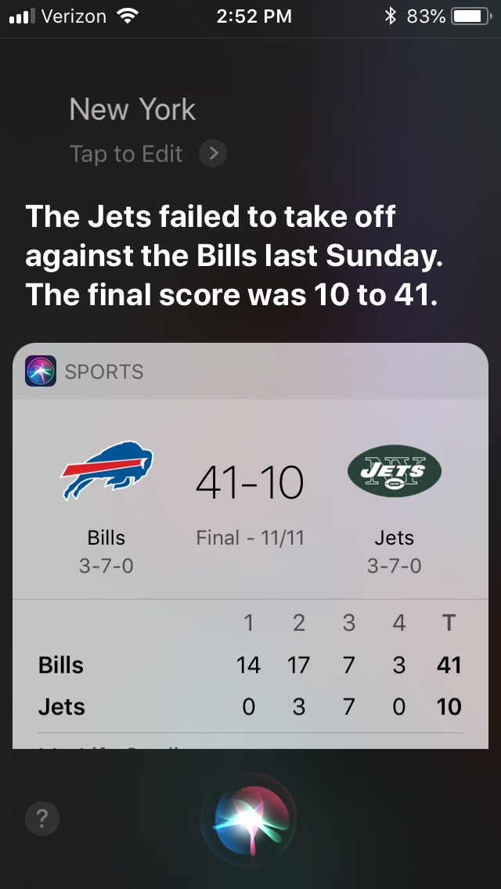
1
2

Slide 13
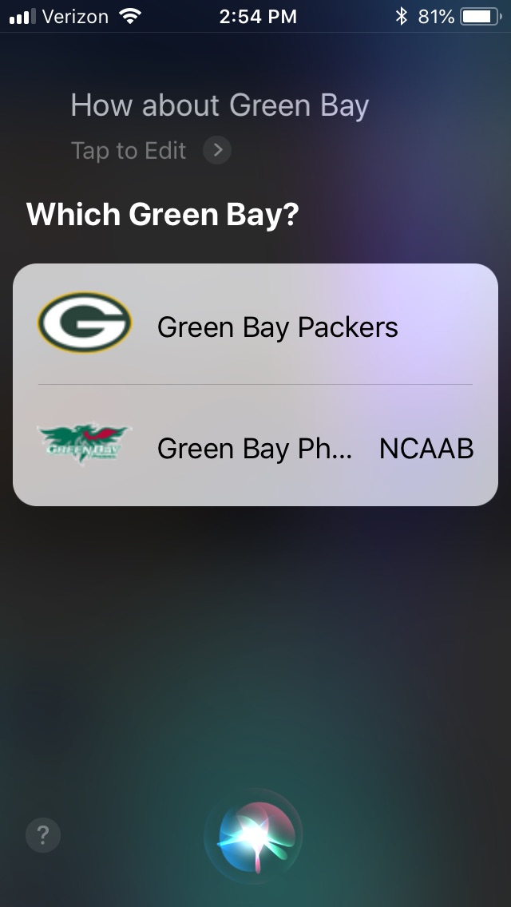
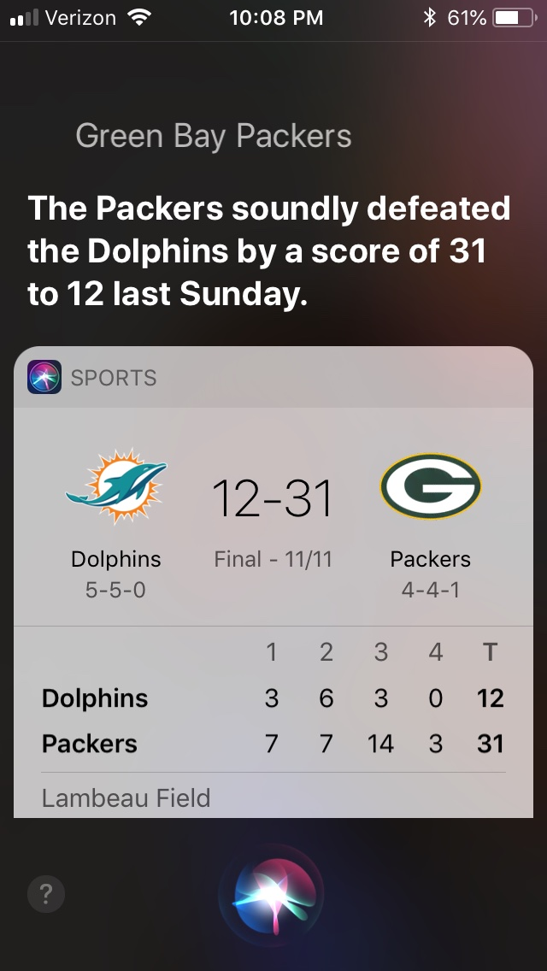
3(?)
4

Slide 14
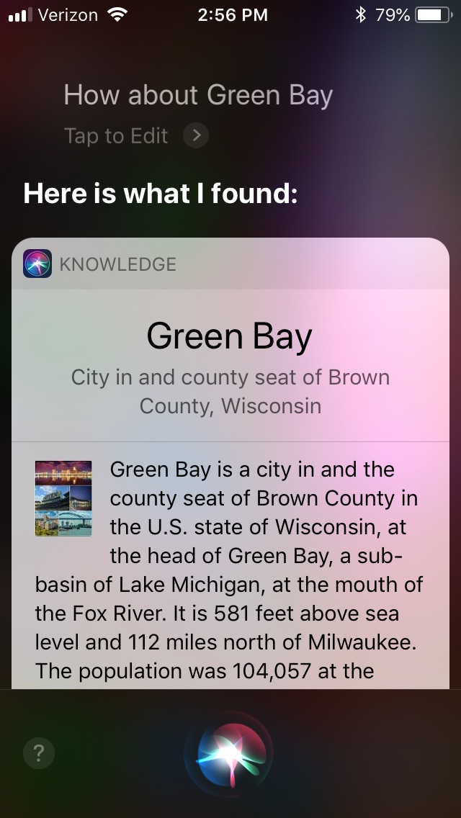
Not a cheap trick!

Slide 15
Frame-based dialog agents
Sometimes called "task-based dialog agents"
Based on a "domain ontology"
A knowledge structure representing user intentions
One or more frames
Each a collection of slots
Each slot having a value

Slide 16
The Frame
A set of slots, to be filled with information of a given type
Each associated with a question to the user
Slot Type Question
ORIGIN city What city are you leaving from?
DEST city Where are you going?
DEP DATE date What day would you like to leave?
DEP TIME time What time would you like to leave?
AIRLINE line What is your preferred airline?

Slide 17
Frame-based dialogue agents
1977:
Still the industrial state of the art
SIRI based on GUS architecture
Artificial Intelligence Journal, 1977

Slide 18
The state of the art in 1977 !!!!

Slide 19
Not super general (emphasis mine)
From abstract: "GUS (Genial Understander System) is intended to engage a sympathetic and highly cooperative human in an English dialog, directed towards a specific goal within a very restricted domain of discourse. As a starting point, GUS was restricted to the role of a travel agent in a conversation with a client who wants to make a simple return trip to a single city in California. "

Slide 20
Slot types can be complex
The type DATE

Slide 21
Control structure for frame-based dialog
Consider a trivial airline travel system:
Ask the user for a departure city
Ask for a destination city
Ask for a time
Ask whether the trip is round-trip or not

Slide 22
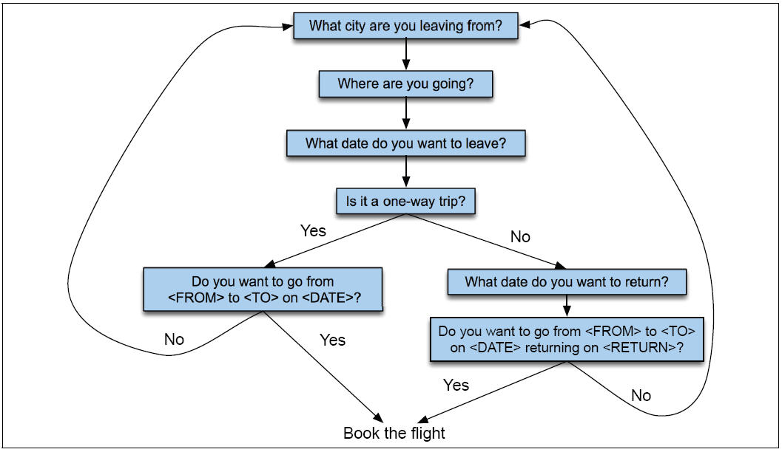
Finite State Dialog Manager

Slide 23
(Full Version...too much detail in general)

Slide 24
Finite-state dialog managers
System completely controls the conversation with the user.
It asks the user a series of questions
Ignoring (or misinterpreting) anything the user says that is not a direct answer to the system’s questions

Slide 25
Dialogue Initiative
Systems that control conversation like this are called single initiative.
Initiative: who has control of conversation
In normal human-human dialogue, initiative shifts back and forth between participants.

Slide 26
Sytem Initiative
System completely controls the conversation
Simple to build
User always knows what they can say next
System always knows what user can say next
Known words: Better performance from ASR
Known topic: Better performance from NLU
OK for VERY simple tasks (entering a credit card, or login name and password)
Too limited
+
-

Slide 27
Problems with System Initiative
Real dialogue involves give and take!
In travel planning, users might want to say something that is not the direct answer to the question.
For example answering more than one question in a sentence:
Hi, I’d like to fly from Seattle Tuesday morning
I want a flight from Milwaukee to Orlando one way leaving after 5 p.m. on Wednesday.

Slide 28
Single initiative + universals
We can give users a little more flexibility by adding universals: commands you can say anywhere
As if we augmented every state of FSA with these
Help
Start over
Correct
This describes many implemented systems
But still doesn’t allow user much flexibility

Slide 30
Instead, the GUS architecture
A kind of mixed initiative
The conversational initiative shifts between system and user
The structure of the frame guides dialogue

Slide 31
Frames are mixed-initiative
System asks questions of user, filling any slots that user specifies
When frame is filled, do database query
If user answers 3 questions at once, system can fill 3 slots and not ask these questions again!

Slide 32
Natural Language Understanding for filling dialog slots
Domain classification
Asking weather? Booking a flight? Programming alarm clock?
Intent Determination
Find a Movie, Show Flight, Remove Calendar Appt
Slot Filling
Extract the actual slots and fillers

Slide 33
Natural Language Understanding for filling slots
Show me morning flights from Boston to SF on Tuesday.

Slide 34
Natural Language Understanding for filling slots
Wake me tomorrow at six.

Slide 35
Rule-based Slot-filling
Write regular expressions or grammar rules
Wake me (up) | set (the|an) alarm | get me up
Do text normalization ("tomorrow evening at 6" -> "18:00")

Slide 36
Siri uses GUS architecture: Condition-Action Rules
Active Ontology: relational network of concepts
data structures: a meeting has
a date and time,
a location,
a topic
a list of attendees
rule sets that perform actions for concepts
the date concept turns string
Monday at 2pm into
date object date(DAY,MONTH,YEAR,HOURS,MINUTES)

Slide 37
Rule sets
Collections of rules consisting of:
condition
action
When user input is processed, facts added to store and
rule conditions are evaluated
relevant actions executed

Slide 38
Part of ontology for meeting task
has-a
may-have-a
meeting concept: if you don’t yet have a location, ask for a location

Slide 40
Machine learning for slot-filling: Domain and Intent
I want to fly to San Francisco on Monday afternoon please
Use 1-of-N classifier (naive bayes, logistic regression, neural network, etc.)
Input:
features like word N-grams
Output:
Domain: AIRLINE
Intent: SHOWFLIGHT

Slide 41
Machine learning for slot-filling:
Machine learning classifiers to map words to semantic frame-fillers
Given a set of labeled sentences
“I want to fly to San Francisco on Tuesday”
Destination: SF
Depart-date: Tuesday
Build a classifier to map from one to the author
Requirements: Lots of labeled data

Slide 42
Machine learning for slot-filling: Slot presence
I want to fly to San Francisco on Monday afternoon please
Use 1-of-N classifier (naive bayes, logistic regression, neural network, etc.)
Input:
features like word N-grams, gazetteers (lists of cities)
Output:
Destination-City

Slide 43
Machine learning for slot-filling: Slot filler
I want to fly to San Francisco on Monday afternoon please
Use 1-of-N classifier (naive bayes, logistic regression, neural network, etc.) for Destination City
Input:
features like word N-grams, gazetteers (lists of cities)
Output:
San Francisco

Slide 44
More sophisticated algorithm for slot filling: IOB Tagging (cf: NER lectures)
IOB Tagging
tag for the beginning (B) and inside (I) of each slot label,
plus one for tokens outside (O) any slot label.
2n + 1 tags, where n is the number of slots.
B-DESTINASTION
I-DESTINATION
B-DEPART_TIME
I-DEPART_TIME
O

Slide 45
More sophisticated algorithm for slot filling: IOB Tagging
IOB Tagging is done by a sequence model
Typical:
Extracted strings can then be normalized (San Fran->SFO)

Slide 46
Other components of SIRI-style architectures
Figure from Jerome Bellegarda

Slide 47
GUS: Still pretty passive
GUS wants to fill slots
What if you stop filling slots and try to ask a question?

Slide 48
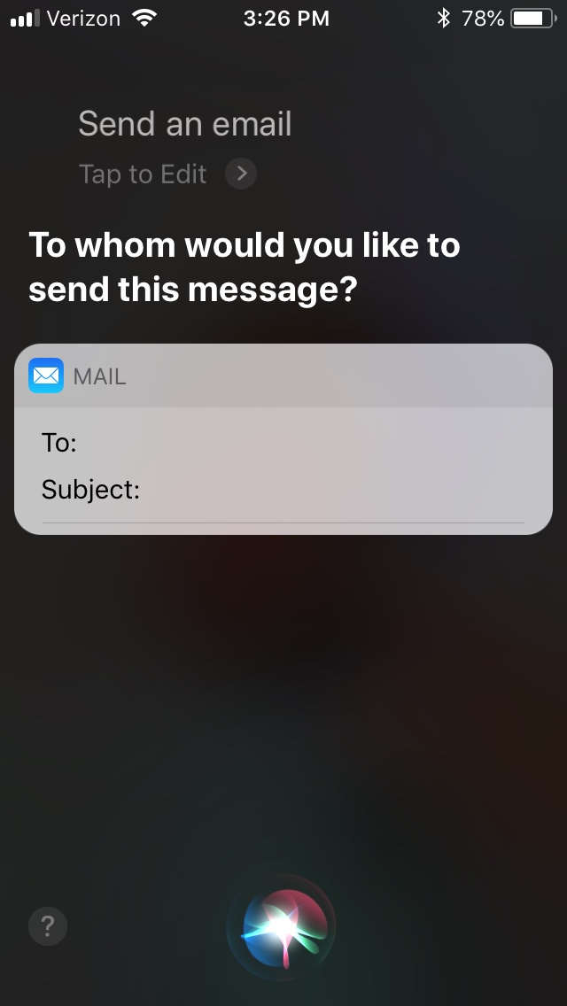
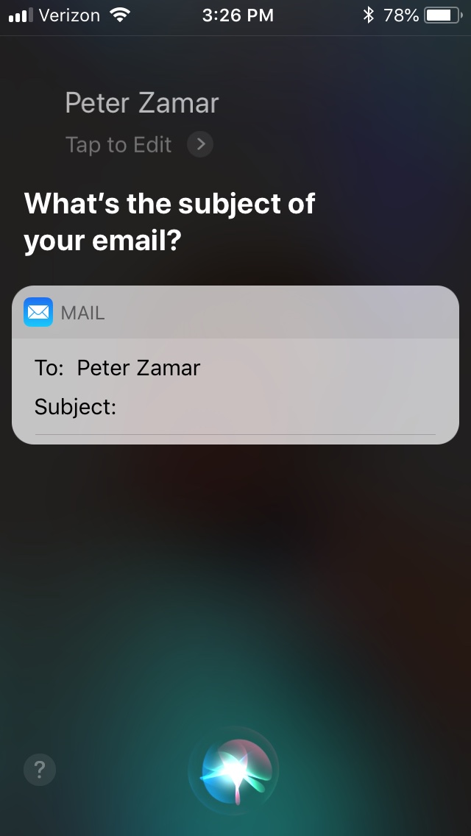

Slide 49
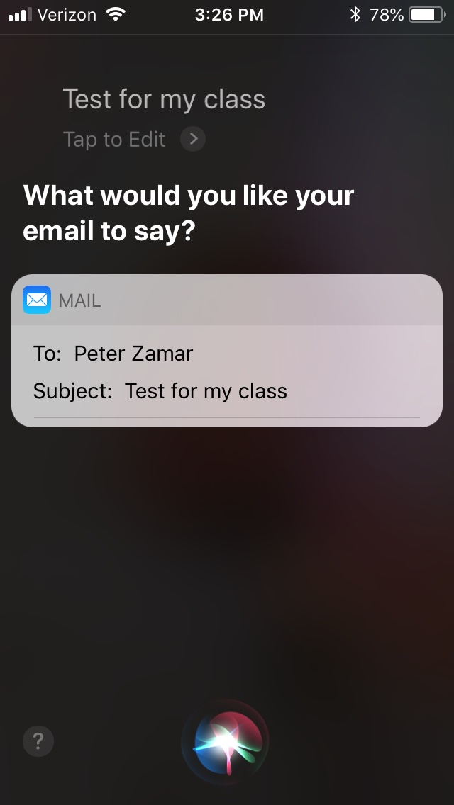
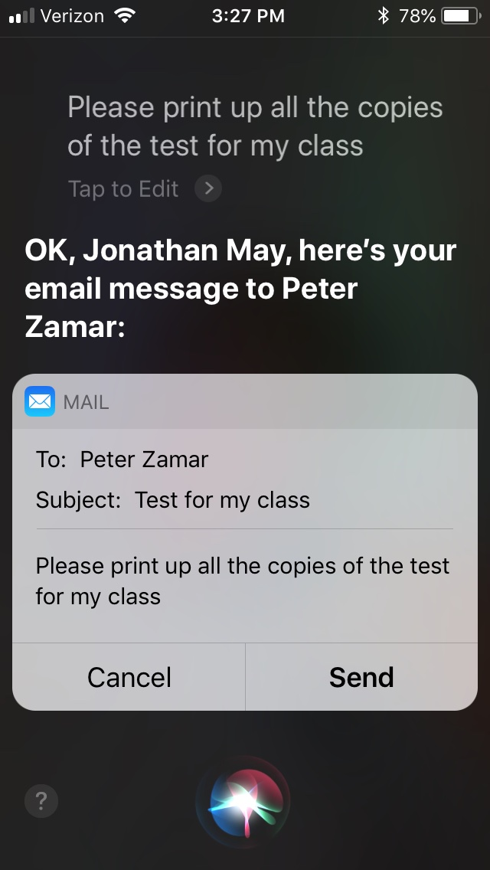

Slide 50
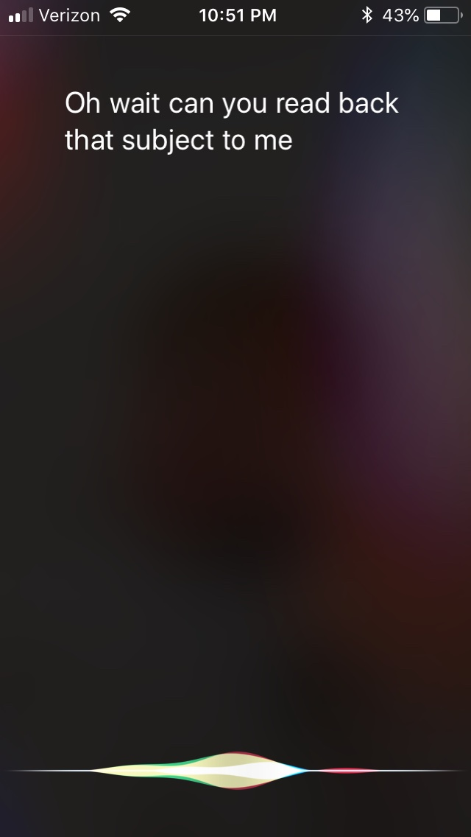

Slide 51
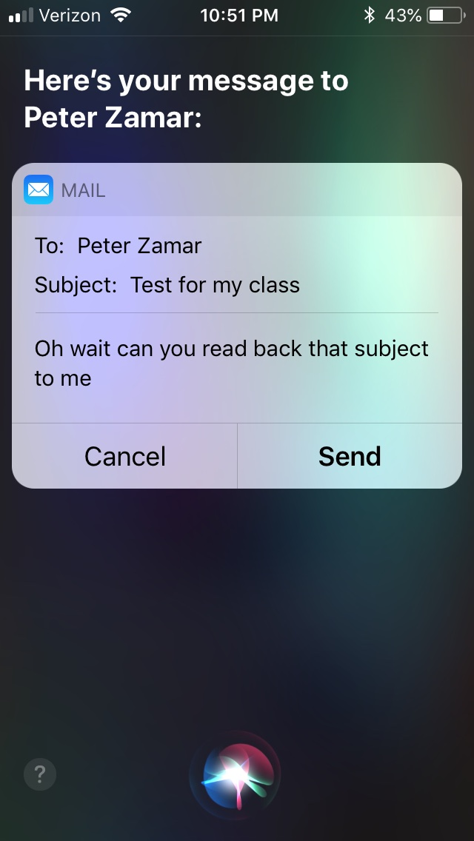

Slide 52
GUS: Still pretty passive
GUS wants to fill slots
What if you stop filling slots and try to ask a question?
What's going wrong?
GUS (siri) doesn't have any real idea of my intents!

Slide 53
Dialog-State Architecture
Like GUS:
Fill in slots
NLU to parse user utterances
Unlike GUS:
Keep track of what the user is doing beyond providing information
Asking a question
Talking to someone else
Understand the discourse context
Requires keeping track of what happened in the past
Two New Components
Dialog State Tracker
Dialog Policy

Slide 55
Dialog Policy
Given the state and the acts, what should happen next
E.g. during email composition:
Sudden question with high intonation? Interpret as command
Otherwise, interpret as text

Slide 56
Dialog Acts
Consider each line in a dialogue to be a kind of action
Just like in an FSA, then, dialog states are the states reached by following dialog act(ion)s.
What are the kinds of dialog acts?
How do we classify dialog lines into acts?

Slide 57
Kinds of Acts
General classes (1979):
Constative: something is the case. Slot filling, constraint establishing, confirmation/denial ("I am flying Tuesday")
Directive: attempt to get the other entity to do something. Adivse/ask/forbid/invite ("Turn up the music")
Commissive: commit to some future course of action. Promise/plan/vow/bet ("I'll book that flight for you")
Acknowledgment: express attitude to other entity with regard to social action. apologize/thanks/greeting ("Nice to see you")

Slide 58
Domain-Focused fine-grained acts

Slide 59
Example

Slide 60
How Is This Done?
Need to identify speech act, then need to find slot-values.
Typically all done at once, in joint state/act-finding procedure:
Speaker | Dialogue | Act/State
User | I'm looking for a cheaper restaurant | INFORM(price=cheap)
System | Sure, What kind and where?
User | Thai food, somewhere downtown | INFORM(price=cheap,food=Thai,area=center)
System | The House serves cheap Thai food
User | Where is it? | Inform(price=cheap,food=Thai,area=center); REQUEST(address)
System | The House is at 106 Regent Street
(Mrkšić et al. 2017)

Slide 61
Syntax Clues
Dialogue | Act | Clues
Will breakfast be served on Delta 1557? | YES-NO QUESTION | Auxiliary ("will") precedes subject ("breakfast")
I don't care about lunch. | STATEMENT | Declarative syntax (no inversion)
Show me flights from LA to SF | COMMAND | No subject
But...
Can you show me the flights from LA to SF? | YES-NO QUESTION | Prosody (if speech)
COMMAND

Slide 62
How It's Done (Neural Belief Tracker)
Note: fixed embeddings
(Mrkšić et al. 2017)

Slide 63
Utterance Representation
Convolutional Neural Net with many offset 1-3-gram filters, max pooled.
Uses fixed word embeddings
Good for long sentences

Slide 64
Match with Various Options
Options come from fixed ontology
Try each one, see which matches best
Important to make representations semantically similar, not just replaceable

Slide 67
More Important Than Model: Data!
DSTC2: Dialogue State Tracking Challenge 2
Transcriptions, ASR hypotheses, and turn-level labels from interactions with a virtual agent
3300+ dialogues about restaurant selection
Fixed Ontology of states
WOZ 2.0
Text archives of wizard-of-oz restaurant selection
No speech, so no asr.
More expressive communication
1200 dialogues

Slide 69
Evaluation
Slot Error Rate for a Sentence
# of inserted/deleted/subsituted slots
# of total reference slots for sentence
End-to-end evaluation (Task Success): # successful dialogues/# dialogues

Slide 70
Evaluation Metrics
“Make an appointment with Chris at 10:30 in Gates 104”
Slot | Filler
PERSON | Chris
TIME | 11:30 a.m.
ROOM | Gates 104
Slot error rate: 1/3
Task success: At end, was the correct meeting added to the calendar?

Slide 71
Results from Neural Belief Tracker

Slide 72
Summary
Task-Oriented Dialogue major paradigm is frame-filling
SOTA in production largely still rule-based
Major accomplishments are multi-turn ability
Newer approaches try to model dialogue acts, build end-to-end understanding
Not much said about response generation here
Next time: more about generation when discussing chit-chat bots

